Slide 1
Amazon Best Selling Books
Presented By: Michael Anaga
Created on: 6/9/2023

Slide 2
Table of Contents
Best Seller
Purpose Statement
Tell your story with Data
Conclusion
Appendix

Slide 3
What are we talking about?

Slide 4
Objective
Analyzing the impact of genres, ratings, and/or reviews on bestseller success.

Slide 5
Present Data

Slide 6
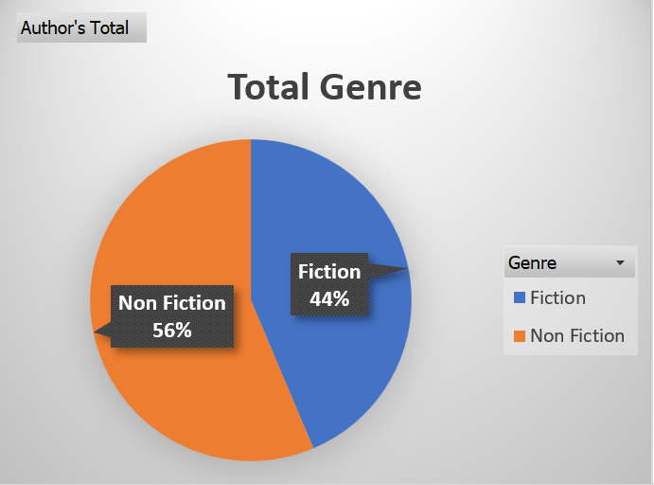
Genre

Slide 7
Genre
Total book genres from 2009 to 2019.

Slide 8
Genre
Total book genres from 2009 to 2019.
Non-fiction books have a production rate 12% higher than fiction books.

Slide 9
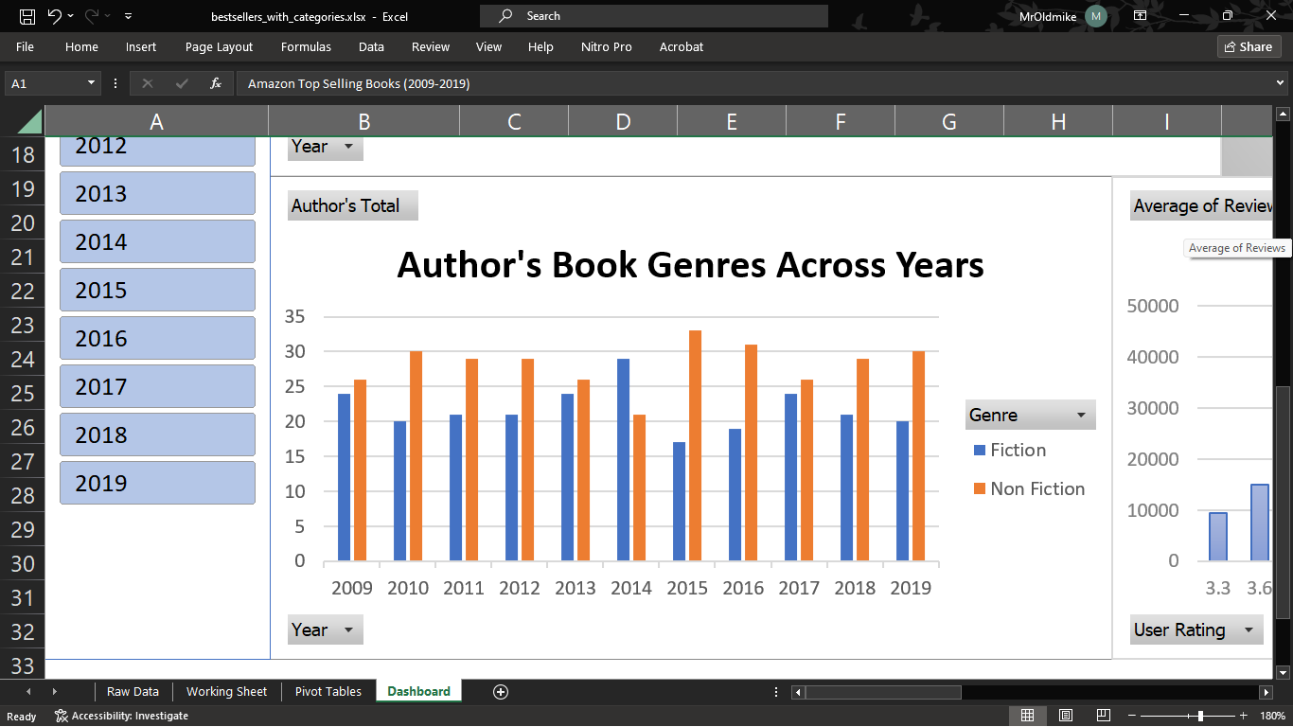
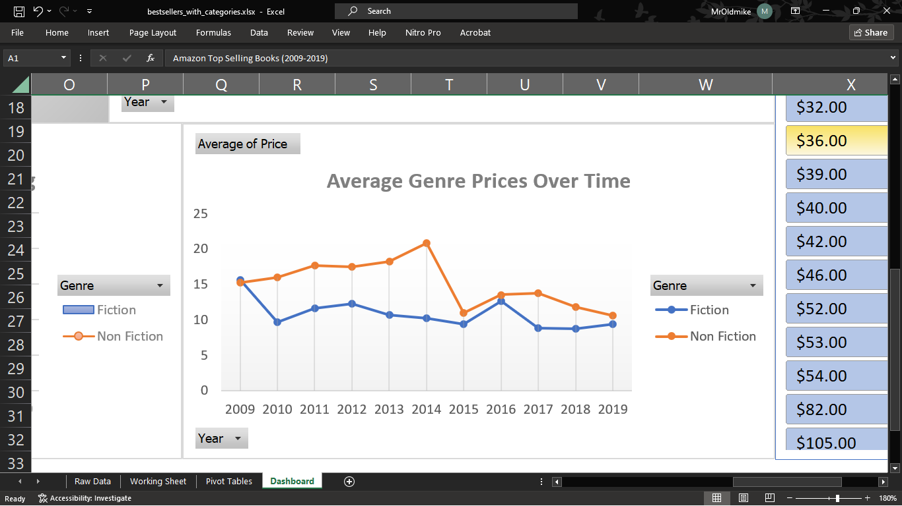
Genre
Total book genres from 2009 to 2019.
Non-fiction books have a production rate 12% higher than fiction books.
Non-fiction books average 15.5% higher value than fiction books.

Slide 10
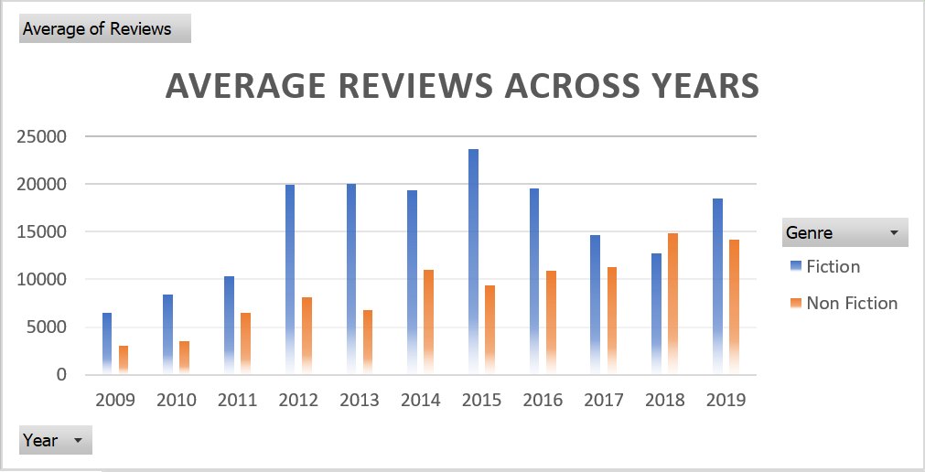
Review
Compared the average reviews across the year (2009 - 2019)

Slide 11
Review
Compared the average reviews across the year (2009 - 2019)
Fiction books receive more reviews than non-fiction books.

Slide 12
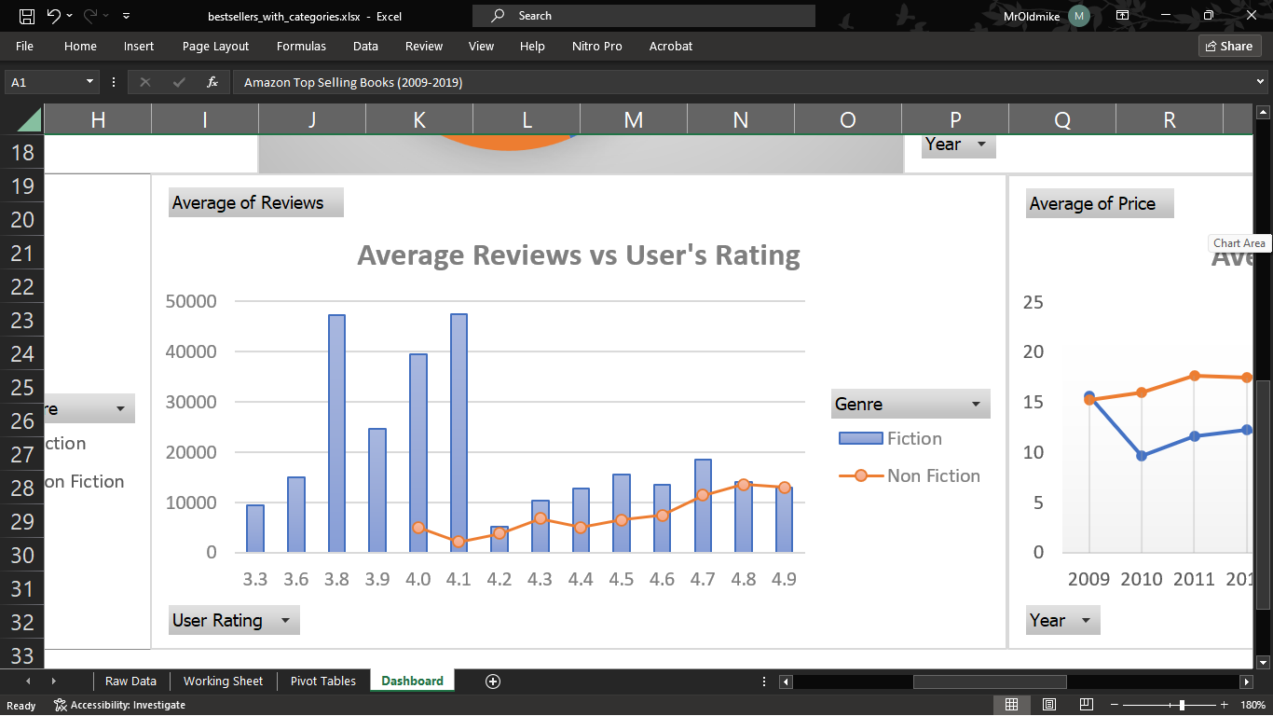
Review
Compared the average reviews across the year (2009 - 2019)
Fiction books receive more reviews than non-fiction books.
No correlation found between average reviews and user ratings based on book genres.

Slide 13
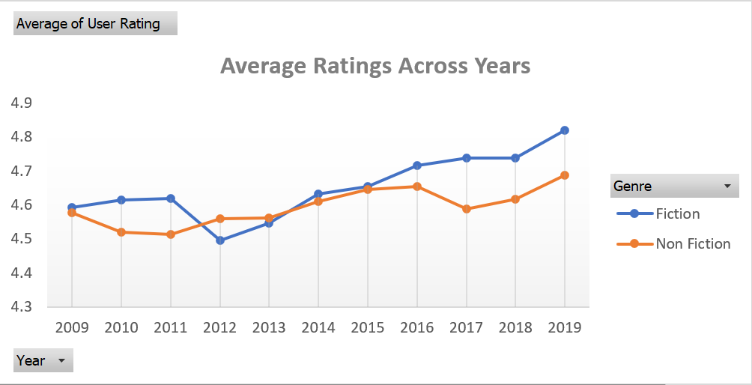
Rating
Compared the average rating across the year (2009 - 2019)

Slide 14
Rating
Compared the average rating across the year (2009 - 2019)
Strong correlation between user ratings and fiction/non-fiction books over the years.

Slide 15
Conclusion

Slide 16
Conclusions
1
Reviews don’t translate to good ratings.
Ratings don’t translate good value

Slide 17
Conclusions
1
2
Reviews don’t translate to good ratings.
Ratings don’t translate good value
Non-fiction books have higher production, fewer reviews, similar ratings, and 15.5% higher value compared to fiction books.

Slide 18
Conclusions
1
2
3
Reviews don’t translate to good ratings.
Ratings don’t translate good value
Non-fiction books have higher production, fewer reviews, similar ratings, and 15.5% higher value compared to fiction books.
*Genre, rating, and value are intertwined, as evidence suggests their close correlation.
*Does not mean there is a causation.
Further analysis needed.

Slide 19
Appendix

Slide 20
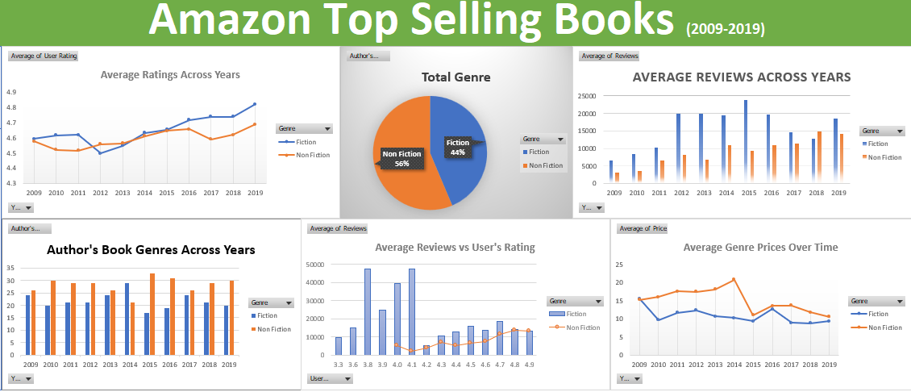

Slide 21
Thank you

